Slide 1

AI-Powered Real Estate Insights
Project: Streamlining Property Search with AI.
Hackathon: GLITCHCON 2025.

Slide 2
Introduction: Revolutionizing Property Search
Purpose
Solution
Simplify and enhance the property search experience.
An AI-powered agent that automates web scraping and data aggregation.
Features
Visually immersive comparisons and personalized recommendations.

Slide 3




Problem Statement: The Pain Points of Traditional Search
Time-Consuming
Manual property comparison is inefficient.
Data Inconsistency
Scattered virtual tours and pricing differences.
Lack of Insights
Difficulty identifying trends and making informed decisions.
Market Inefficiencies
Missed opportunities due to slow analysis.

Slide 4
Our Solution: AI-Driven Property Analysis
AI Agent
Data Aggregation
AI Algorithms
Automated web scraping from Shobha, Prestige, etc
Centralized database with standardized property information.
Predictive analytics for valuation and neighborhood scoring.

Slide 5

Technology Stack & Implementation
Languages
Python (Scrapy, Beautiful Soup), JavaScript (React).
AI/ML Libraries
TensorFlow, scikit-learn.
Database
MongoDB for flexible data storage.

Slide 6
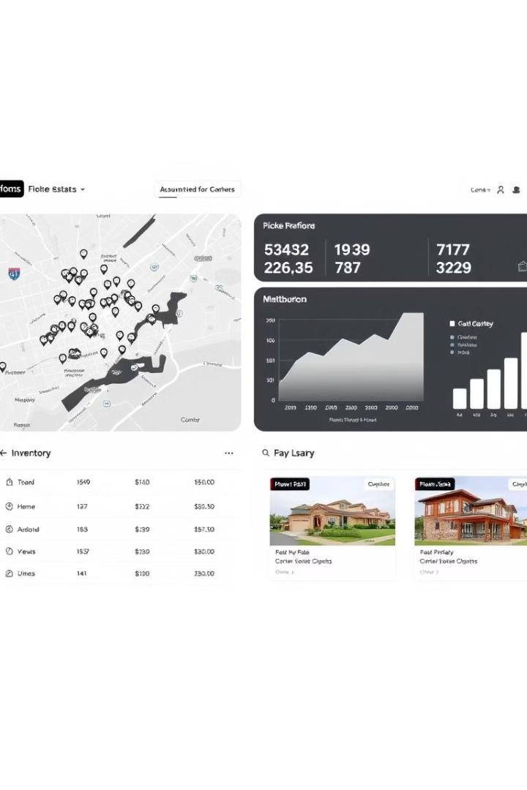


Visualizing Insights: Immersive Property Comparisons
Interactive Dashboard
Virtual Tours
Integrated virtual tours and high-resolution images.
Side-by-side property comparison with key metrics.

Slide 7

Features
NLP Chatbot
Personalized recommendations via user preferences.
Predictive Analytics
Advanced models for forecasting property values.
Scalability
Expand data sources and geographic coverage.

